Slide 1


Slide 2
TABLE OF CONTENTS
Project Description
Task Assigned
Tech-Stack Used
Approach
Insights
Results
Conclusion
Drive Links

Slide 3
Project Description
The automotive sector has expanded quickly, emphasizing technological innovation, environmental sustainability, and fuel efficiency. It is critical to comprehend the elements influencing car demand as the market becomes more competitive and consumer tastes change.
Along with alternative fuel sources like hydrogen and natural gas, electric and hybrid vehicles are becoming more and more popular.
Despite this, conventional gasoline-powered vehicles continue to be widely used, and various fuel kinds and grades are available. Car manufacturers can find popular features and profitable categories by analyzing the relationship between features, market categories, and pricing, hence optimizing pricing and product development decisions.
Regression analysis and market segmentation are two examples of data analysis approaches that can help producers create a pricing plan that balances profitability and customer demand while concentrating on product characteristics for future development.

Slide 4
The names of the columns used to analyze the data are:
Make: The make or brand of the car
Model: The specific model of the car
Year: The year the car was released
Engine Fuel Type: The type of fuel used by the car (diesel, etc.)
Engine HP: The horsepower of the car's engine
Engine Cylinders: The number of cylinders in the car's engine
Transmission Type: The type of transmission (automatic or manual)
Driven Wheels: The type of wheels driven by the car (rear, all)
Number of Doors: The number of doors the car has
Market Category: The market category the car belongs to (Performance, etc.)
Vehicle Size: The size of the car
Vehicle Style (Body Style): The style of the car (Coupe, etc.)
Highway MPG: The estimated miles per gallon the car gets on the highway
City MPG: The estimated miles per gallon the car gets in the city
Popularity: A ranking of the popularity of the car (based on the number of times it has been viewed on Edmunds.com)
MSRP: The manufacturer's suggested retail price of the car

Slide 5
Task Assigned
Analysis Tasks:
Task 1: How does the popularity of a car model vary across different market categories?
Task 2: What is the relationship between a car's engine power and its price?
Task 3: Which car features are most important in determining a car's price?
Task 4: How does the average price of a car vary across different manufacturers?
Task 5: What is the relationship between fuel efficiency and the number of cylinders in a car's engine?
Dashboard Creation Tasks:
Task 1: How does the distribution of car prices vary by brand and body style?
Task 2: Which car brands have the highest and lowest average MSRPs, and how does this vary by body style?
Task 3: How do the different features such as transmission type affect the MSRP, and how does this vary by body style?
Task 4: How does the fuel efficiency of cars vary across different body styles and model years?
Task 5: How does the car's horsepower, MPG, and price vary across different Brands?

Slide 6
Tech-Stack Used
For this project, the following tools were utilized:
MS Excel 2021:
Used for data analysis.
Excel's built-in functions, formulas and tools were crucial for performing calculations.
Generated visualizations to illustrate data trends and patterns.
Summarized the results effectively.
MS PowerPoint 2021:
Created a presentation to showcase project insights.
Ensured the information was presented in a clear and visually appealing format.
Google Drive:
Saved the final report for easy access.
Shared the report with others to facilitate collaboration and review.

Slide 7
Approach
Data Collection and Familiarization:
The project commenced with downloading the provided dataset.
I then proceeded to thoroughly review the project details to gain a comprehensive understanding of the objectives and requirements.
Data Cleaning and Preparation:
The dataset underwent a data cleaning process in Excel.
Data types were adjusted, missing values were handled, and other formatting tasks were performed to ensure ease of analysis.
Data Analysis:
Created pivot tables to summarize and aggregate data, enhancing the understanding of variable relationships.
Performed regression analysis to identify variables strongly related to car price.
Used bar charts, scatter plots, line charts, and bubble charts to present the findings visually.
Dashboard Building:
Added filters and slicers to enhance interactivity.
Included visualizations like stacked column charts, scatter plots, and line charts to create an informative dashboard.
Project Report:
Created a project report upon completing the data analysis and dashboard.
The report, made using PowerPoint, provides a detailed explanation of the project.

Slide 8
Insights
Popularity by Market Category:-
With a total of 19,33,488 models, the "Flex Fuel" market category is the most popular, closely followed by the "Crossover" category with 16,86,521.
Despite "Flex Fuel" being the most popular category, "Crossover" has a higher number of models than "Flex Fuel.“
Despite their comparatively lower popularity, the "Luxury," "Luxury Performance," and "Performance" categories nevertheless have a sizable variety of models available.
Price Variation Based on Engine Power:-
A clear relationship exists between Engine HP and car prices; as Engine HP increases, the average car cost also rises.
For example, cars with an Engine HP of 55 have an average cost of $2,000, while cars with an Engine HP of 1,001 have an average cost of $1,757,223.67.
Relative Importance of Car Features on Price:-
Regression analysis indicates that "vehicle size" has the least impact on the vehicle's price, while "engine cylinder" has the highest importance.
Other features with notable influence on car price include "City MPG," "Highway MPG," "Engine HP," "Vehicle Style," and "Engine Fuel Type.“
Price Comparison Across Manufacturers:-
"Bugatti," "Ferrari," and "Rolls Royce" are the manufacturers with the highest average car prices.
"Bugatti" has the highest average price range, while "Rolls Royce" has the lowest average price range among these manufacturers.
Relation between Cylinders and Highway MPG:-
An inverse relationship exists between the number of engine cylinders and average highway MPG.
Cars with fewer engine cylinders generally achieve higher average highway MPG, while cars with more engine cylinders tend to have lower average highway MPG.

Slide 9
Insights
Car Price Distribution by Body Style and Brand:-
The distribution of car prices varies by brand and body type, with several brands and body types displaying unique price ranges.
For instance, "Mercedes-Benz" offers a variety of body types and has a total MSRP of $30,68,812, whilst "Bugatti" manufactures automobiles with an average MSRP of $1,39,850.
Average MSRP by Car Brand and Body Style:-
"Bugatti" has the highest average MSRP, primarily due to its luxury body style. "Ferrari" follows closely with two body styles: "Coupe" and "Convertible.“
"Plymouth" and "Hyundai" have the lowest average MSRP among manufacturers, despite offering multiple body styles.
Impact of Transmission Type on MSRP by Body Style:-
The average MSRP is influenced by transmission type, especially when considering various body types.
For instance, the highest average MSRP is found in automobiles with "automated manual" transmissions, while the lowest average MSRP is found in cars with "manual" transmissions.
Fuel Efficiency Across Body Styles and Model Years:-
Fuel efficiency, indicated by city MPG and highway MPG, varies among different body styles and model years.
While fuel efficiency fluctuates over the years, there is an overall trend of improvement in both city and highway MPG.
Examining Differences in Price, MPG, and Horsepower Among Car Brands:-
Vehicle brands differ greatly in terms of pricing, city/highway MPG, and engine horsepower.
The "Toyota" balance, for instance, has 170 horsepower, 11.1 city, 40.8 highway, and an average cost of $35,511. In comparison, "Bugatti" has a high horsepower of 1,001 but a poor MPG and an average price that is far higher at $1,757,223.

Slide 10
RESULTS

Slide 11
Analysis Task 1: How does the popularity of a car model vary across different market categories?

Slide 12
Analysis Task 2: What is the relationship between a car's engine power and its price?

Slide 13
Analysis Task 3: Which car features are most important in determining a car's price?

Slide 14
Analysis Task 4: How does the average price of a car vary across different manufacturers?

Slide 15
Analysis Task 5: What is the relationship between fuel efficiency and the number of cylinders in a car's engine?

Slide 16
Dashboarding Task 1: How does the distribution of car prices vary by brand and body style?

Slide 17
Dashboarding Task 2: Which car brands have the highest and lowest average MSRPs, and how does this vary by body style?

Slide 18
Dashboarding Task 3: How do the different features such as transmission type affect the MSRP, and how does this vary by body style?

Slide 19
Dashboarding Task 4: How does the fuel efficiency of cars vary across different body styles and model years?

Slide 20
Dashboarding Task 5: How does the car's horsepower, MPG, and price vary across different Brands?

Slide 21
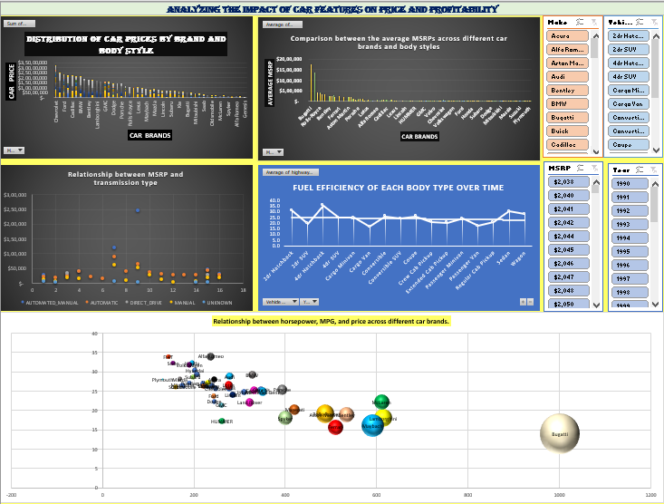
Final Dashboard

Slide 22
Conclusion
The analysis of the car dataset uncovered several key insights regarding car prices, market categories, car features, and fuel efficiency.
The main conclusions are as follows: Price Variation: Car prices differ significantly by brand and body style. Brands like Bugatti, Maybach, and Rolls Royce have higher average MSRPs, while the choice of body style also affects the price range, with some styles commanding higher prices. Engine Power: Engine horsepower is a major factor in car pricing. Vehicles with higher horsepower generally have higher average costs, reflecting customer willingness to pay more for increased engine performance. Feature Impact: Key features such as engine cylinder count, city and highway MPG, engine HP, vehicle style, and fuel type influence car prices. Understanding these factors is crucial for manufacturers to set competitive prices and cater to customer preferences. Fuel Efficiency: There are variations in fuel efficiency across different body styles and model years. Although there have been overall improvements in fuel efficiency, differences remain, which can help buyers select more fuel-efficient vehicles.

Slide 23

Google Drive link for the dataset:
https://docs.google.com/spreadsheets/d/1mvfT177sCRViMZlNBa-ZJeYPudch8oCk/edit?usp=sharing&ouid=103027981944924775198&rtpof=true&sd=true

